Slide 1
Education in Wisconsin
Senator Dale Kooyenga

Slide 2
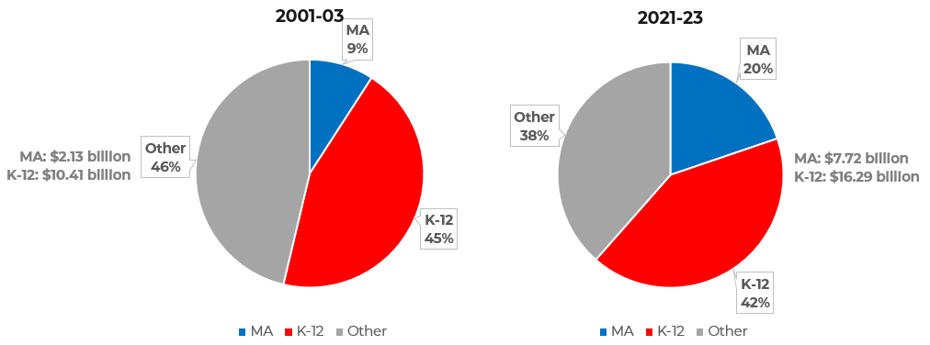
Trends – Funding
Growing Medical Assistance costs are putting pressure on K-12 funding
SOURCE: LEGISLATIVE FISCAL BUREAU
Notes:
Figures are GPR spending. See LFB memo.
Maybe explain GPR vs. FED/PR/SEG

Slide 3
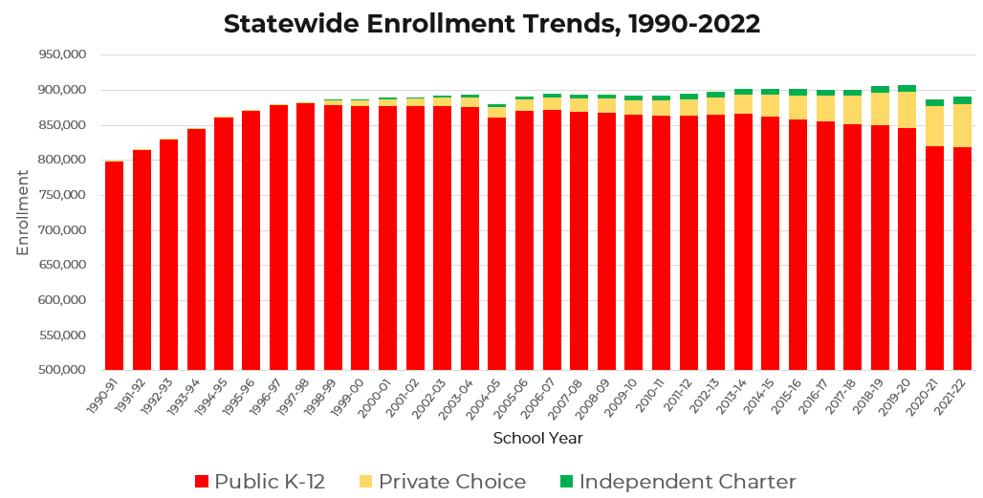
Trends - Enrollment
Enrollment in choice/charter programs is growing, while public K-12 enrollment is trending down
SOURCE: LEGISLATIVE FISCAL BUREAU
Notes:
Figures are GPR spending. See LFB memo.
Note that Y-axis starting point is 500K to emphasize trends.
Note that LFB provided enrollment data for *independent* charter schools
2004-05 dip: Not sure what’s up with that. LFB error?

Slide 4
School Choice in Wisconsin
Milwaukee Parental Choice Program
Provides state-funded vouchers, allowing parents of limited means in Milwaukee to send their child to a private school if they choose to do so.
Established in 1989 Act 336
Enrollment cap: None
2011 Act 32 deleted enrollment caps, raised income limit to 300% FPL
First private school voucher program in the country
Enrollment: 28,583
State spending on MPCP: $237.7 million GPR in 2021-22
$204 million net GPR in 2020-21 (after General Aid reduction)
Notes:
https://docs.legis.wisconsin.gov/misc/lfb/informational_papers/january_2021/0028_private_school_choice_and_special_needs_scholarship_programs_informational_paper_28.pdf
2021-22 GPR spending is preliminary; $204M net GPR is latest available data for that figure.

Slide 5
School Choice in Wisconsin
Racine choice program
Very similar to MPCP for children in the Racine Unified School District.
Established in 2011 Act 32
Enrollment cap: None
Enrollment (2021): 3,835
State spending on Racine program: $31.8 million (2020-21)
$6.1 million net GPR (after General Aid reduction)

Slide 6
School Choice in Wisconsin
Statewide School Choice
Statewide expansion of school choice programs previously established in Milwaukee and Racine.
Established in 2013 Act 20
Initially capped at 500 pupils in 2013-14 and 1,000 in 2014-15
2015 Act 55 reduces caps, eliminating all caps by 2026-27
Income limit: Currently 220% FPL
Enrollment (2021): 12,111
State spending: $99.2 million (2020-21)
$3.4 million net GPR (after General Aid reduction)

Slide 7
School Choice in Wisconsin
Special Needs Scholarship Program
Expansion of school choice for children with an individualized education program (IEP).
Established in 2015 Act 55
No income limits or participation caps
Enrollment (2021): 1,425
Per pupil payments are equal to $12,977 in 2020-21
State spending on SNSP: $18 million (2020-21)
$0 net GPR (after General Aid reduction)

Slide 8
School Choice Enrollment
SOURCE: LEGISLATIVE FISCAL BUREAU
Notes:
Private Schools column is number of participating schools
Aid Membership is number of students

Slide 9
Choice Program Costs
In 2020-21, per pupil (AKA “per member”) payments were $8,300 for a pupil enrolled in grades K-8 and $8,946 for a pupil enrolled in 9-12
When accounting for state aid and property tax, that’s less than average per pupil spending on public K-12 ($14,321 per pupil)
SOURCE: LEGISLATIVE FISCAL BUREAU

Slide 10
School Choice is Popular
59% in Milwaukee metro counties have a favorable view of school vouchers
66% of African Americans support; 60% of Hispanics
Plurality (45%) statewide support; 38% disapprove
Charters were supported by 54% of respondents, ESAs by 52%
High support for charters (62%) among African American respondents
High support for charters (68%) among Hispanic respondents
POLL SOURCE: WISCONSIN INSTITUTE FOR LAW & LIBERTY
Notes:
https://will-law.org/wp-content/uploads/2021/01/will-poll-memo-final.pdf
More support school vouchers than oppose.
--45% of respondents supported the state’s voucher programs while only 38% oppose.
--Majority support (59%) in Metro Milwaukee counties. o Plurality support (42%) out-state.
--High support (66%) among African Americans.
--High support (60%) among Hispanics
--Majority support (53%) among Millennials/Gen Z (ages 18 to 37).
--Vouchers remain far more popular among Republicans (66%) than Democrats (27%).
Charters, Education Savings Accounts (ESA) receive majority support.
--Charters were supported by 54% of respondents, ESAs by 52%. o High support for charters (62%) among African American respondents.
High support for charters (68%) among Hispanic respondents.

Slide 11
Charter Schools
Charter Schools
May be authorized by public school districts, the Milwaukee Common Council, any UW Chancellor, any Tech College board, the Waukesha Co. executive, the OEO at UW-Madison, and tribal colleges (Wis. Stat. 118.40)
Instrumentality: school board employs all staff in the charter school
Non-instrumentality: a non-profit board employs all staff in the charter school, not the school board
Independent (ICS): authorized by a body other than a public school district
MPS state funding: $9,573 (2020-21)
Milwaukee independent charter funding: $9,165 per pupil (2020-21)
Notes:
OEO: Office of Educational Opportunity
DPI info sheet: https://dpi.wi.gov/sites/default/files/imce/sped/ffc/charter-funding-overview-handout.pdf
Independent Charter School Payment Amount
In the 2021-2022 academic year, Independent Charter Schools will receive $9,201 as the per pupil payment amount. In the 2022-2023 academic year, Independent Charter Schools will receive $9,264 as the per pupil payment.
However, per Wis. Stat. 118.40(2r)(f)1, in the 2021-2022 academic year, Independent Charter Schools authorized by the College of Menominee Nation or the Lac Courte Oreilles Ojibwe College will receive $8,853 as the per pupil payment amount.
118.40 Charter schools.
a. The common council of the city of Milwaukee.
b. The chancellor of the University of Wisconsin-Milwaukee.
c. The chancellor of the University of Wisconsin-Parkside.
d. The Milwaukee area technical college district board.
e. Each technical college district board other than the Milwaukee area technical college district board.
eg. The chancellor of any institution in the University of Wisconsin System other than the University of Wisconsin-Milwaukee and the University of Wisconsin-Parkside.
f. The county executive of Waukesha County.
g. The college of Menominee Nation.
h. The Lac Courte Oreilles Ojibwa community college.

Slide 12
Public School Funding Formula
Extremely complex formula
Two types of state aid – General Aids and Categorical Aids
General Aids –
Includes General School Aids and High Poverty Aid
Distributed through an “equalization aid formula” based on the district's per pupil value of taxable property
$4.92 billion GPR in 2020-21
Aid to each district is dependent on property value within district, an attempt to “equalize” per pupil funding across districts
Notes:
https://docs.legis.wisconsin.gov/misc/lfb/informational_papers/january_2021/0027_state_aid_to_school_districts_informational_paper_27.pdf

Slide 13
Public School Funding Formula
Categorical Aids
Aid dependent on various factors by district
There are 30 categories of Categorical Aids
Largest categories by spending are Per Pupil Aid, Special Education Aid, Achievement Gap Reduction Aid, Sparsity Aid and Pupil Transportation Aid
$1.37 billion GPR in 2020-21
Notes:
https://docs.legis.wisconsin.gov/misc/lfb/informational_papers/january_2021/0027_state_aid_to_school_districts_informational_paper_27.pdf

Slide 14
Public School Funding Formula
Total state aid in the 2021-23 budget (general + categorical school aids):
$6.4 billion in 2021-22
$6.7 billion in 2022-23
$13.1 billion biennial total
Two-thirds funding
Objective since the 1990s
2021-23 budget added $600 million to K-12 directed at local property tax relief
That increase brought state aid up to the 2/3 funding objective

Slide 15
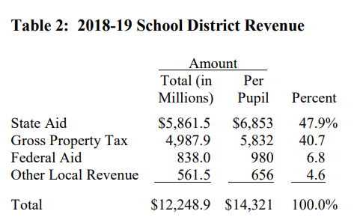
State Aid is Only Half the Picture
State aid averaged $6,853 per pupil in 2018-19*
Local property taxes brought in another $5,832 per pupil
Total average per pupil: $14,321
SOURCE: LEGISLATIVE FISCAL BUREAU
*Most recent school year for which audited data was available

Slide 16
State Funding Differences
Zero-or-low General School Aid districts
Property rich districts get less state aid
Example: Lake Country ($75.87/pupil in 2020-21)
A handful of districts got no General School Aid
High General School Aid districts
Property poor districts get much more state aid
Example: Milwaukee Public Schools ($8,227 in 2020-21)
Notes:
https://docs.legis.wisconsin.gov/misc/lfb/misc/173_2021_22_general_school_aids_amounts_for_all_school_districts_12_3_21.pdf
Of the total amount of funding provided, 398 of the state's 421 school districts are eligible for $4,945.2 million in equalization aid, 25 districts are eligible for $40.3 million in integration aid, and 62 districts are eligible for $28.1 million in special adjustment aid.

Slide 17
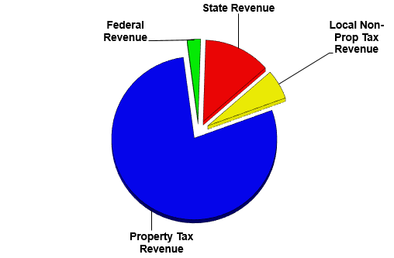
Funding Breakdown Example: Elmbrook
State aid was $1,924 per pupil in 2019-20
Local property tax revenue was $11,545 per pupil
Federal aid was $384 per pupil
Local non-property tax revenue was $894 per pupil
Total: $14,718 per pupil
SOURCE: DEPARTMENT OF PUBLIC INSTRUCTION
Notes:
Source: DPI WISEdash data

Slide 18
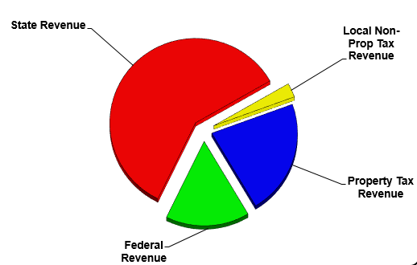
Funding Breakdown Example:
MPS
State aid was $9,427 per pupil in 2019-20
Local property tax revenue was $3,487 per pupil
Federal aid was $2,500 per pupil
Local non-property tax revenue was $429 per pupil
Total: $15,844 per pupil
SOURCE: DEPARTMENT OF PUBLIC INSTRUCTION
Notes:
Source: DPI WISEdash data

Slide 19
Public School Funding vs. Enrollment
SOURCE: MACIVER INSTITUTE

Slide 20
Where Does the Money Go?
SOURCE: MACIVER INSTITUTE
Notes:
Instruction is mainly traditional teacher salaries.
Pupil/Staff/Support would include non-traditional instruction like speech language pathologists, counselors, etc.

Slide 21
Federal Windfall
ESSER I/II/III
WI schools received $2.6 billion from three rounds of ESSER, a program created in the CARES Act and supplemented by subsequent Covid funding bills, mainly ARPA
90% of the money distributed according to Title IX formula (i.e., according to poverty levels of districts)
10% distributed according to plan developed by Joint Finance Committee. Joint Finance voted to establish a minimum of $781 per pupil for districts that were open 50% to in-person instruction
Biggest beneficiary: MPS ($11,242 additional per pupil) for a total of $742 million

Slide 23
Several Covid Bills Provided Federal K-12 Aid
SOURCE: MACIVER INSTITUTE

Slide 24
Federal Aid Was a Massive K-12 Windfall

Slide 25
Referenda
Revenue limits
The annual amount of revenue that school districts can raise through general school aids, property taxes, and exempt property aid programs is capped by state law
Districts must ask permission from voters to exceed revenue limits
Vary by district from $10,007/pupil (Hilbert) to $24,116/pupil (Phelps)
Three types: recurring, nonrecurring and debt
2021: 64 referenda statewide, 56% were approved
2022: 81 referenda statewide, 79% were approved
Notes:
https://docs.legis.wisconsin.gov/misc/lfb/informational_papers/january_2021/0026_school_district_revenue_limits_and_referenda_informational_paper_26.pdf

Slide 26
Tradition of Local Control
421 school districts in Wisconsin
Traditionally, Wisconsin school boards have great autonomy on spending, referendum, curriculum, staffing and other decisions
Notable Federal Acts
Every Student Succeeds Act
No Child Left Behind Act
Individuals with Disabilities Education Improvement Act

Slide 27
Education Innovations
Dual Enrollment
Includes a variety of programs allowing high school students to earn both high school and college credit at the same time
Lowers the cost of college and provides more challenging coursework for those who choose it
Reading Corps
College Possible
City Year Milwaukee
Boys & Girls Clubs Education and Career Development
Notes:
Boys & Girls Club Programs: https://www.bgcwisconsin.org/education-career-development
-Wisconsin After 3
-Be Great: Graduate
-Stride Academy
-Career Launch
-Diplomas2Degrees
-Summer Brain Gain
-DIY Stem
-Project Learn
-Junior Staff
-Money Matters
-Power Hour
-Tech Girls Rock
https://dpi.wi.gov/dual-enrollment
https://dpi.wi.gov/sites/default/files/imce/dual-enrollment/2020_03_02_Dual_Enrollment_Guidance.pdf
https://www.cityyear.org/Milwaukee

Slide 28
Future Reforms?
Universal school choice – lifting all caps and income limits
Education Savings Accounts – broadly popular (52% support)
“Funding follows the student” – overhaul of how we fund schools so all funding is student-centric, rather than school-centric
Notes:
https://will-law.org/wp-content/uploads/2021/01/will-poll-memo-final.pdf

Slide 29
Questions/Discussion

